Slide 1

Predicting customer buying behaviour

Slide 2
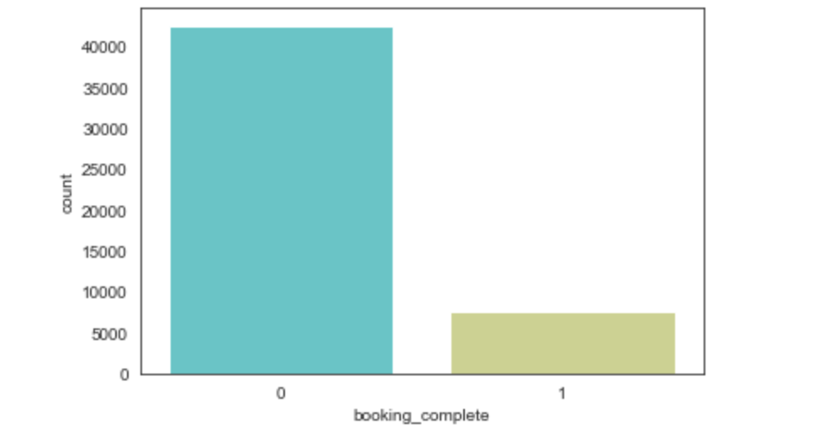
Insights
From the analysis, there are 42522 complete bookings and 7478 incomplete bookings

Slide 3
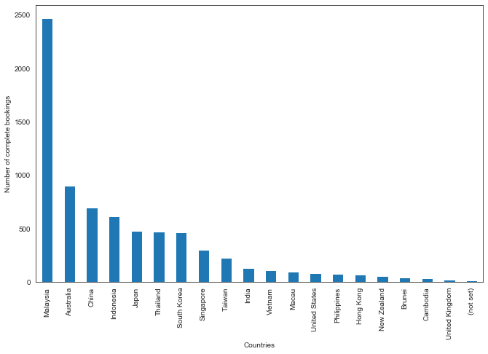
Insights
The Malaysia has the most complete bookings.

Slide 4
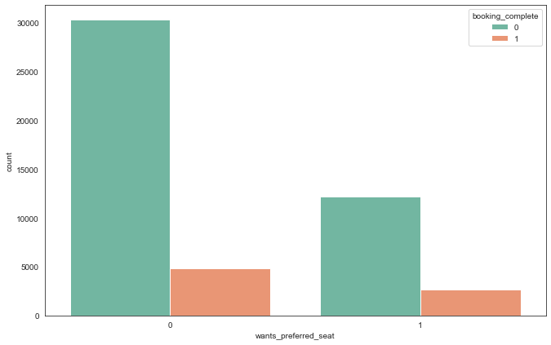
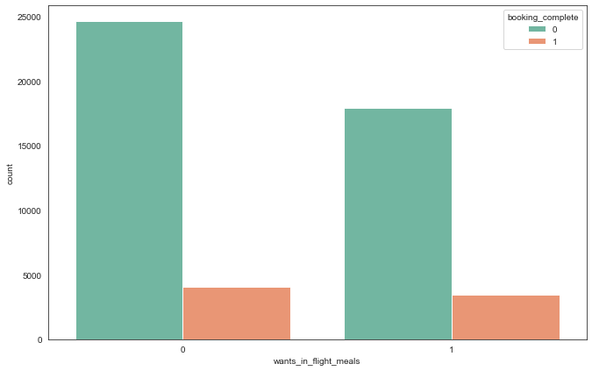
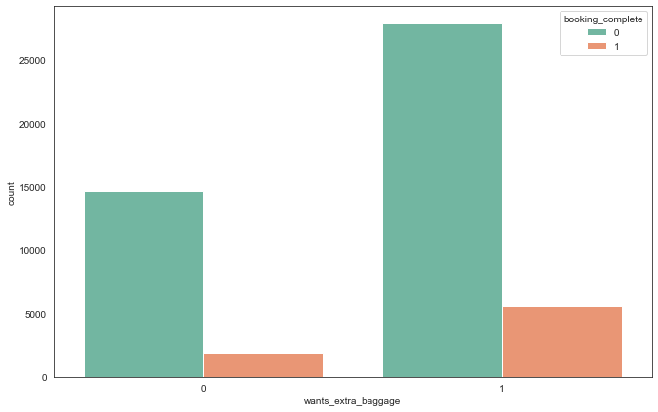
Insights
Customers who prefer the preferred meals and flight meals are more willing to complete the booking.

Slide 5
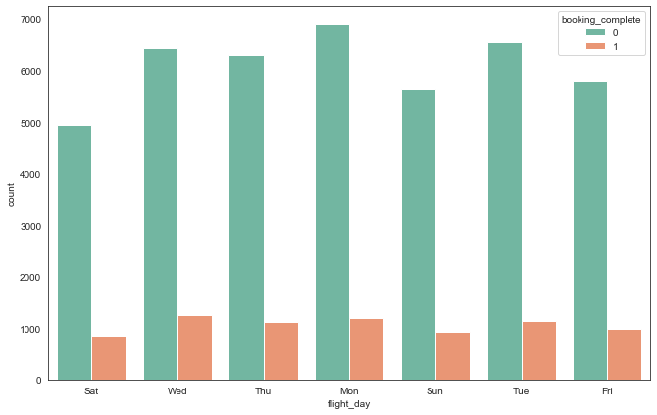
Insight
On Saturday, there is the least number of complete bookings.

Slide 6
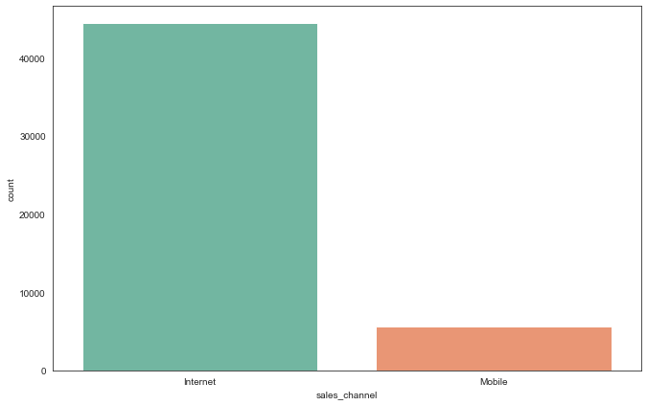
Insight
Customers are more willing to book the flight through Internet.

Slide 7
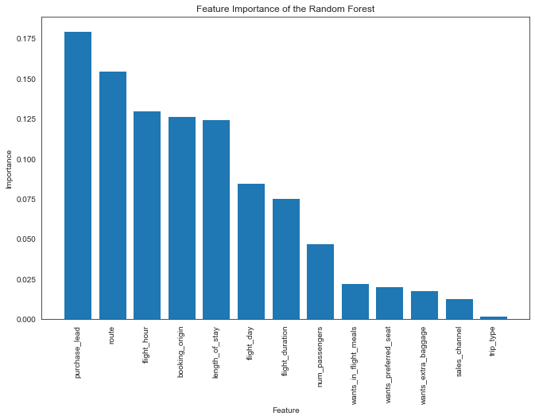
The most important feature is Purchase_lead

Slide 8
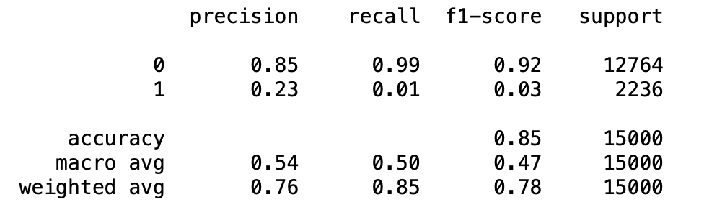
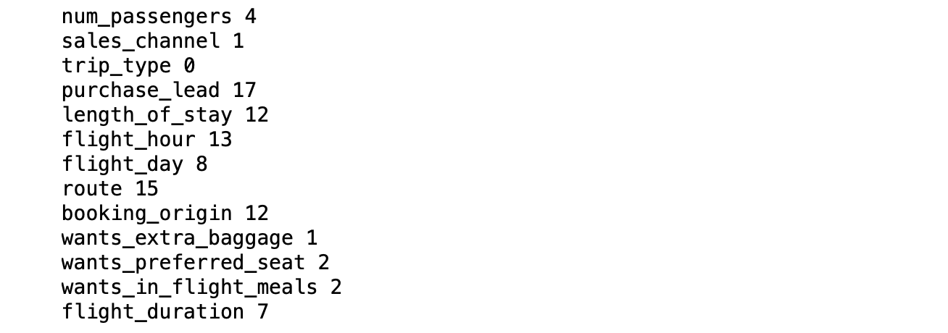
Results
With top five features, the accuracy of model to predict the successful booking based on RandomForestClassifier is 0.85

